Slide 1
Introduction to accessibility
Defra Accessibility Team
Introduction v1.0
Notes:
Good afternoon.
I’m [YOUR NAME] from the Defra Accessibility Team. My colleague [THEIR NAME] is also here [and will be presenting with me today].
[Describe speaker if needed by people who cannot see the video clearly - eg I’m a white man with short grey hair and light beard. I wear rimless glasses. I’m wearing a light blue shirt and a dark grey jumper.]
Is there anyone who can’t see these slides clearly?

Slide 2
If you need this document in a more accessible format, email the Defra Accessibility Team at accessibility@defra.gov.uk

Slide 3
This talk is 45 minutes long.
Questions in the chat. We’ll take them at the end.
Notes:
Today we’ll be spending about 45 minutes introducing website accessibility.

Slide 4
What do you know already?
S = not a lot
M = something
L = quite a bit
Notes:
Please type in the chat to let us know what you know already about accessibility.
S = not a lot
M = something
L = quite a bit
It’s OK not to type anything if you prefer. [Summarise, roughly, the results - eg “OK most of you say you don’t know a lot about accessibility”]

Slide 5
A few stories
Notes:
Let’s start by taking a closer look at some stories about everyday situations.

Slide 6
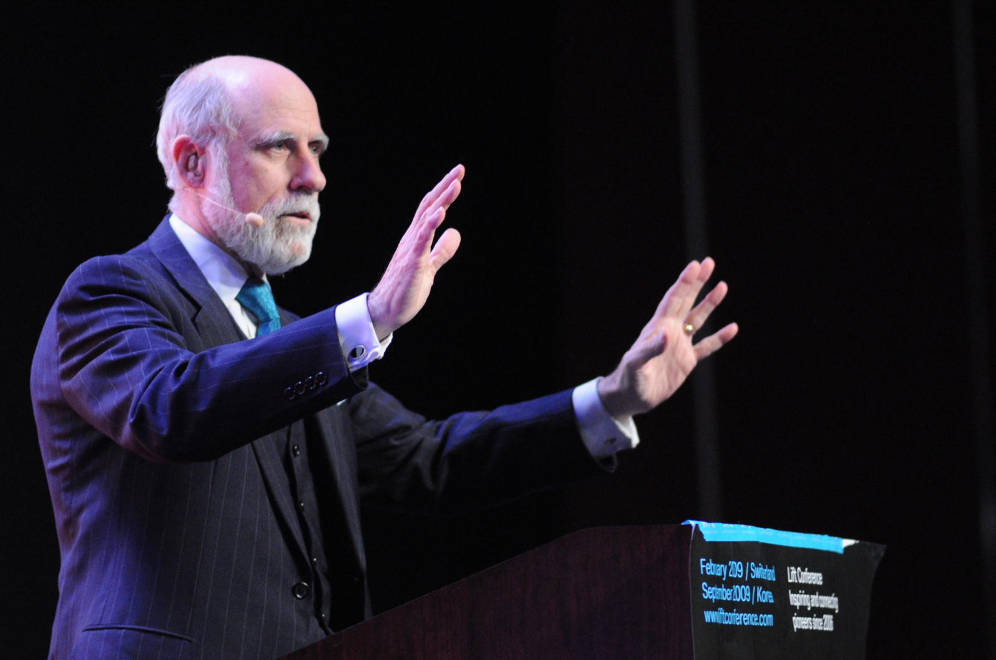
Vint Cerf
WikiMedia
Notes:
This is Vint Cerf.

Slide 7
Designed TCP/IP
Developed the first commercial email system
One of "the fathers of the Internet"
Google Chief Internet Evangelist
Fellow of the Royal Society
Has worn hearing implants from the age of 13
“[email] was hugely attractive to me because it replaced uncertain voice calls with the clarity of text”
Notes:
Designed the TCP/IP protocol with Bob Kahn
Helped develop the first commercial email system on the Internet
Internet pioneer and one of "the fathers of the Internet"
Google vice president and Chief Internet Evangelist
Fellow of the Royal Society
Has worn hearing implants from the age of 13
“[email] was hugely attractive to me because it replaced uncertain voice calls with the clarity of text”
The moral of this story? Poor accessibility creates barriers which risks excluding people. There are hundreds of examples of people who faced barriers and yet made a brilliant contribution to humankind.
Ref: https://blog.google/inside-google/googlers/vint-cerf-accessibility-cello-and-noisy-hearing-aids/

Slide 8
About 1 in 6 (16%) of people are deaf or hard of hearing.
10 million people in the UK.

Slide 9
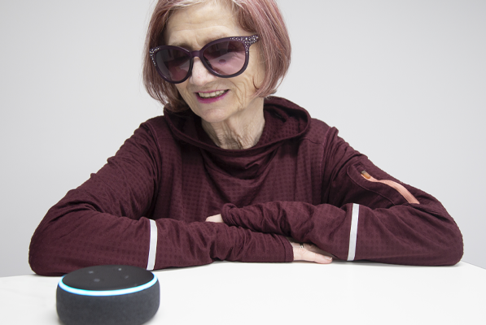
RNIB
Dolly McLoughlin
(and Alexa)

Slide 10
“I can use emails and documents, but I find navigating the internet with a screen reader very difficult indeed. Websites are all designed differently, which makes it hard to find what I am looking for.”
“Alexa is different. I can just ask her questions and she will tell me the answer.”
Notes:
The moral of this story? Not every disabled person is an expert in assistive technology. Disabled people may also have low digital skills.

Slide 11
About 1 in 30 (3%) of people are blind or partially sighted.
2 million people in the UK.

Slide 12
Photo © BBC
Notes:
This photo simulates colour deficiency.
The footballer in the middle has red kit and it is hard to distinguish against the crowd.

Slide 13
Photo © BBC
Notes:
Bruno Fernandes shoots while in action for Portugal.
Wearing a red top, he seems easy to pick out.

Slide 14
Photo © BBC
Notes:
Imagine you are a trainer or referee and you hand out fluorescent tabards to help tell with team is which.

Slide 15
Photo © BBC
Notes:
This photo simulates colour deficiency.
How would you feel about training, or referring this match if you had colour deficiency?

Slide 16
In 2014, the FA Cup swapped its white ball for a pink Nike football.
Colour blind people couldn’t distinguish the ball from the pitch.
The FA swapped back just a few months after.
Notes:
In partnership with Uefa, the FA co-authored colour blindness guidelines that are now being adopted by more clubs and national associations. Reference: https://www.bbc.co.uk/sport/football/53986570

Slide 17
1 in 12 males (8%) have a colour vision deficiency.
3 million people in the UK.
Notes:
It’s about 1 in 200 for females.

Slide 18
What happens if circumstances disable us?
Notes:
The social model of disability describes people as being disabled by barriers in society, not by our impairment or difference.
You may not have impairments but you too may be faced with situations or circumstances that disable you. Let’s look at some of these.

Slide 19
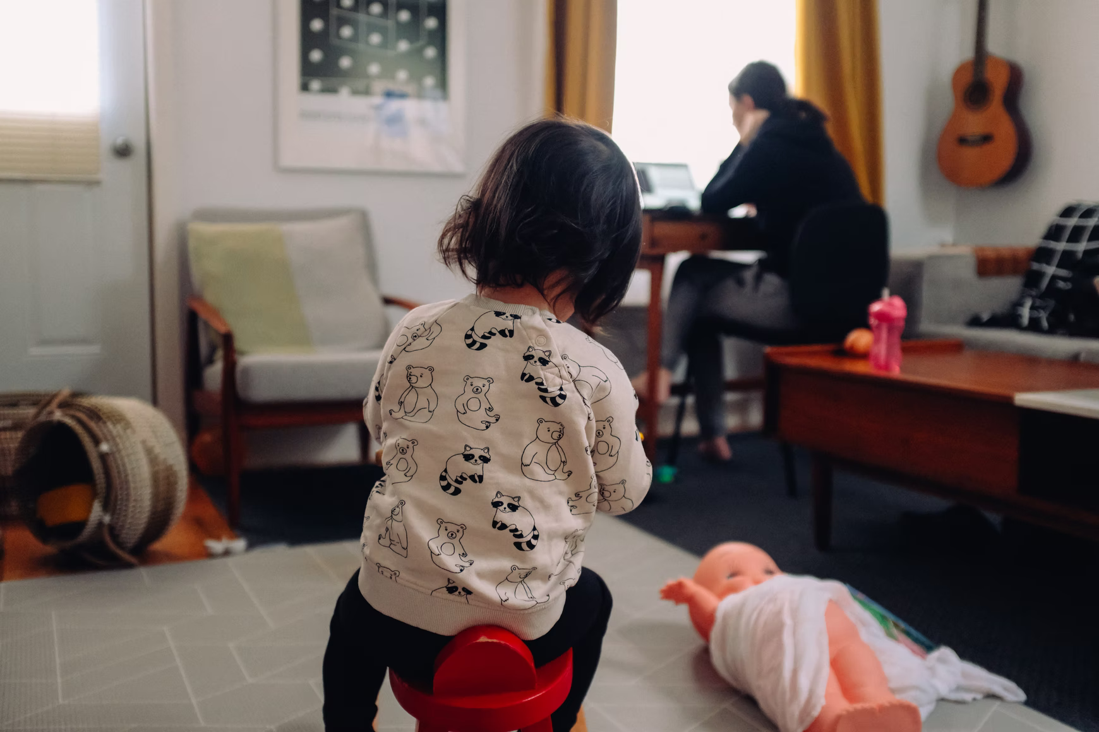
UnSplash
Notes:
Imagine we had a situation - hard to imagine I know - where your users for some reason, had to work at home so they were distracted by children, deliveries and others working from home? What if the software they had to work on increased the cognitive load such that they kept losing track of what they were doing - or made mistakes?

Slide 20
Unsplash
Occupational Health called, I need to stop using a mouse

Slide 21
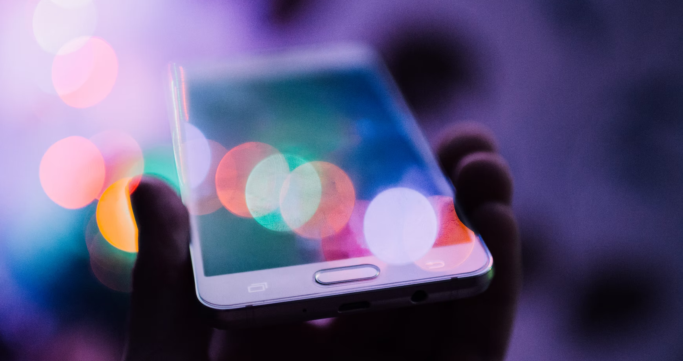
Unsplash
Bright sunshine makes it hard to read my phone outdoors

Slide 22
WikiMedia
Fluid leaked inside Chris Hadfield’s space suit and irritated his eyes so he was unable to see mid-spacewalk
Notes:
Nasa astronaut Chris Hadfield might be keen to hear that. He made headlines in 2001 when cleaning fluid leaked inside his visor and irritated his eyes so he was unable to see mid-spacewalk.
Had tactile and audio information been available to him, not only would it have benefitted a blind crew but Hadfield might have felt safer too.

Slide 23
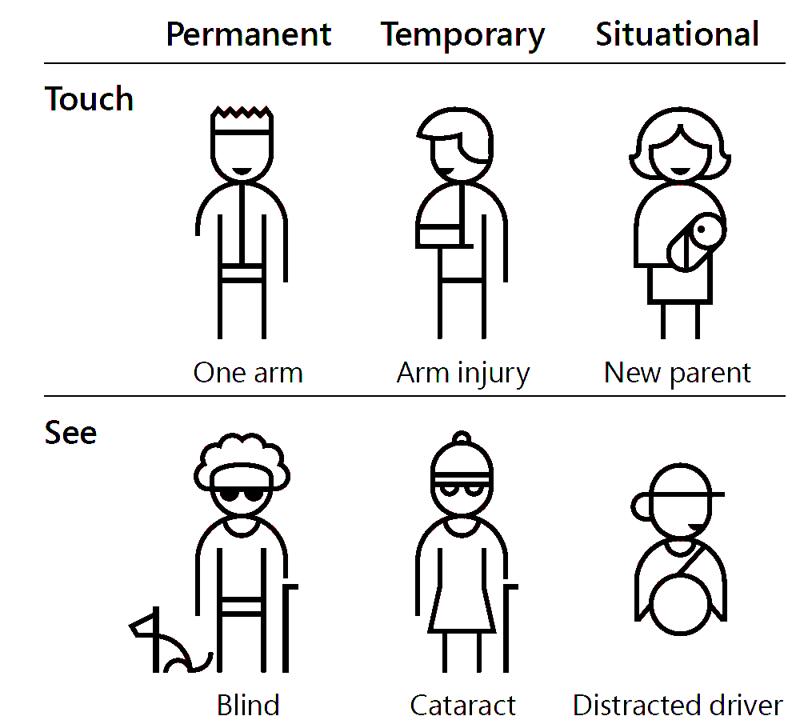
Not all disabilities are permanent
Notes:
Accessibility is not just about screen readers. You might:
break your arm or wrist
get repetitive strain injury (RSI)
injure an eye or develop an eye condition
You might prefer to use different screen colours
need to use the application on a phone or tablet (on a train, or whilst moving)
get older
Not all disabilities are permanent.
[Alt text: Illustration of permanent, temporary and situational disability for touch and sight. Touch disability - permanent is having one arm; temporary is having an arm injury; situational is having a new baby to hold. Seeing disability: permanent is being blind; temporary is having a cataract; situational is being a distracted driver.]

Slide 24
Most people use accessibility features

Slide 25
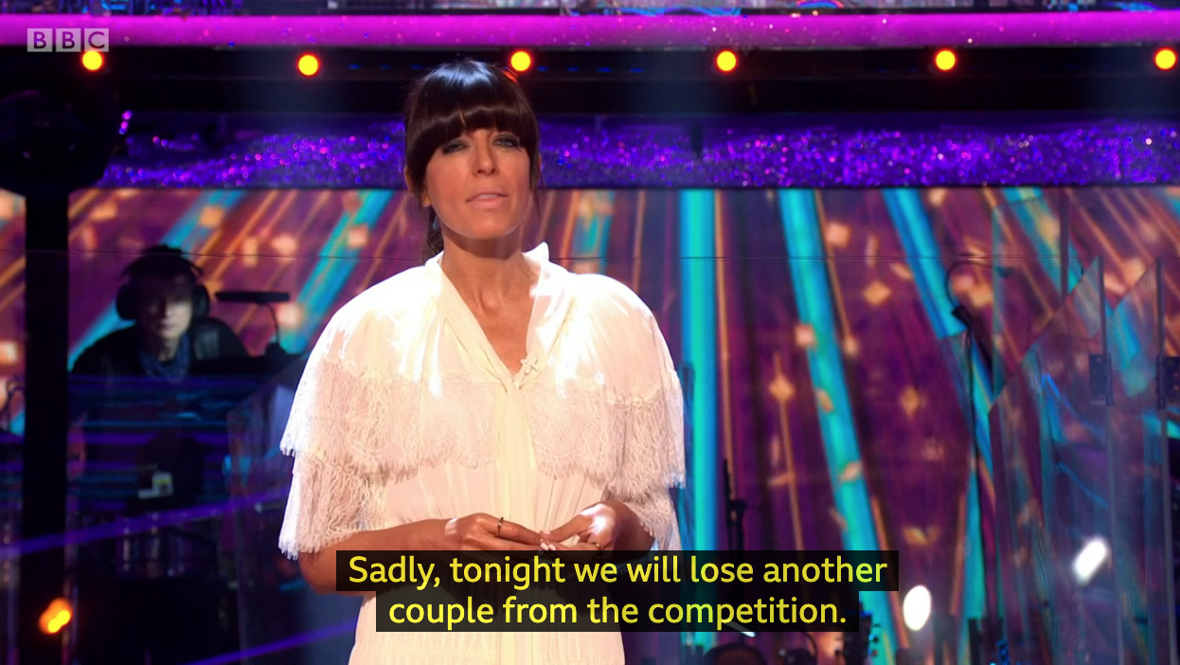
Notes:
Any Strictly fans? Do you ever watch with subtitles while you are doing something else? Or watch the news on subtitles in a waiting room? Or switch on subtitles when actors mumble?
[Alt text: Screen capture from BBC Strictly Come Dancing showing Claudia Winkleman with onscreen subtitles “Sadly, tonight we will lose another couple from the competition”]

Slide 26
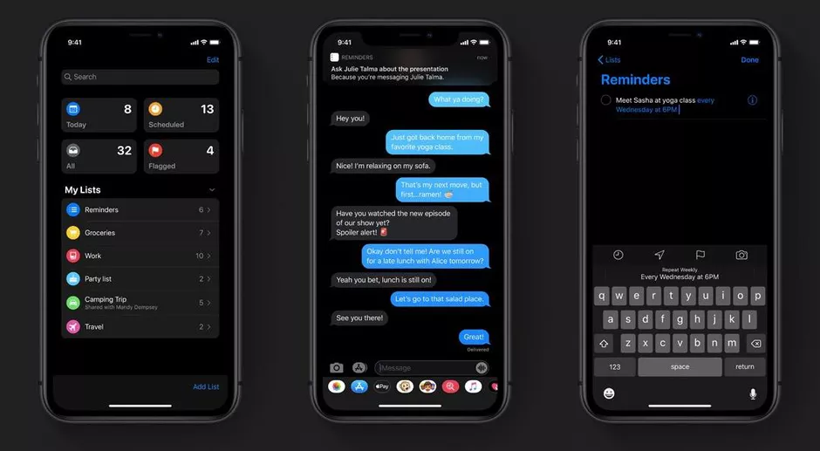
Notes:
Has anyone tried dark mode on your phone? Is it easier on your eyes? Would it be frustrating if one app or website didn’t work well with dark mode?
[Alt text: 3 screenshots of iPhone in dark mode where the screen has mostly a black background]

Slide 27
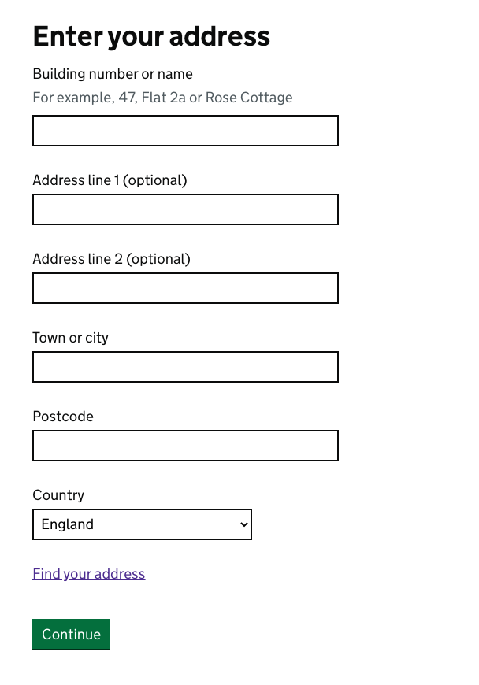
Notes:
Does anyone here use the tab key to move through forms? How would you feel if it got stuck half way down the page? If you haven’t tried it, have a go next time you fill in a form - it’s a time saver.
[Alt text: tab key on a computer keyboard]

Slide 28
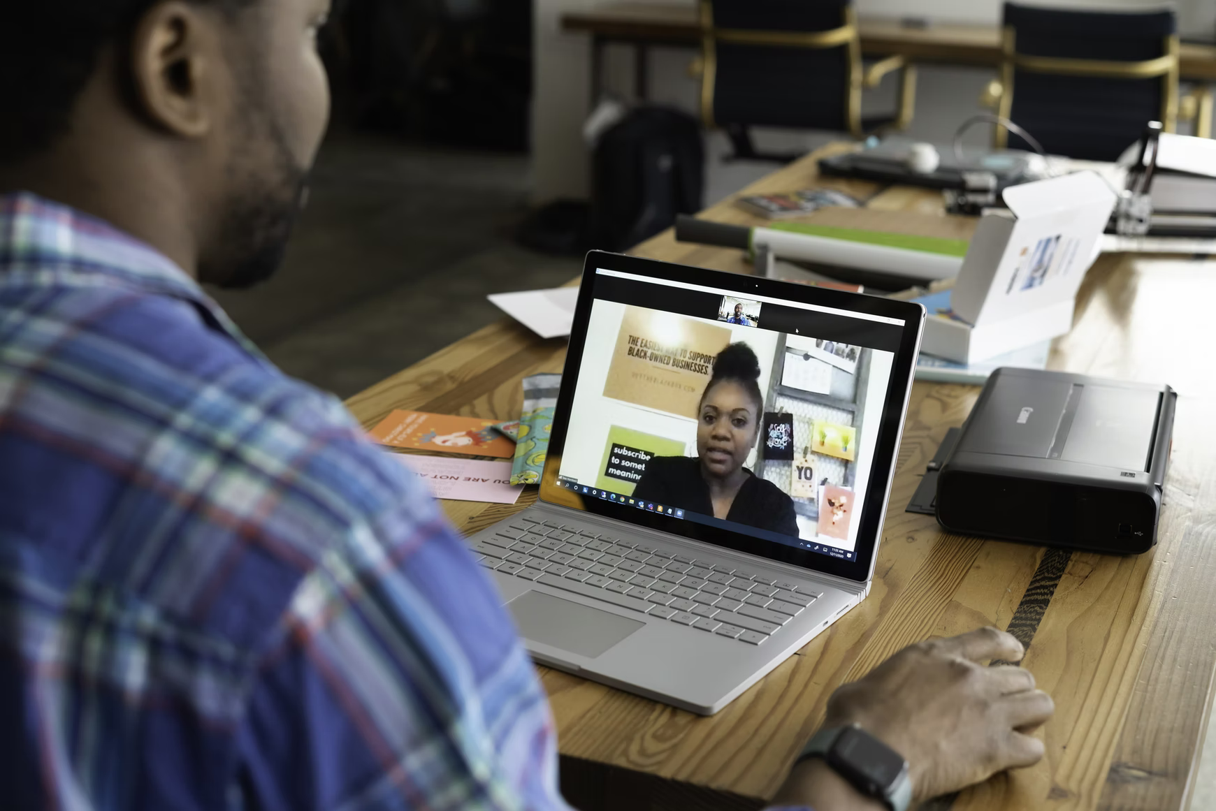
UnSplash
Notes:
You’re on a Teams call.
[Alt text: A worker at a desk using a laptop to make a video call to another person.]

Slide 29
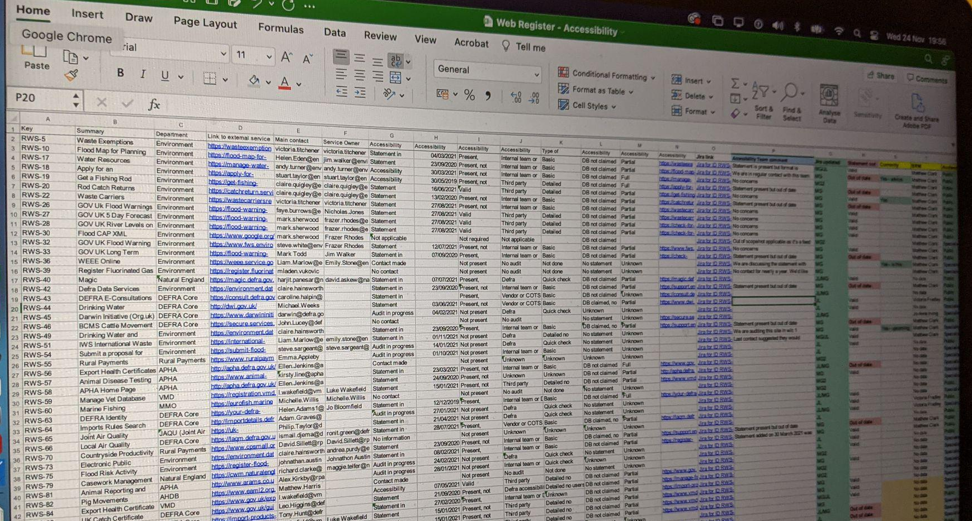
Defra
Can you make that a bit bigger please?
Notes:
And someone asks - can you make that a bit bigger please. The text is too small to read. What if the software or website did not allow you to increase the text size?
[Alt text: photo of a computer screen showing a spreadsheet with a really small font size]

Slide 30
60% of people without disabilities use some kind of accessibility feature
Notes:
It may surprise you to know that 60% of people without disabilities use some kind of accessibility feature. For example, video captions, text zoom, dark mode, tabbing between form fields.
You probably use some of these.

Slide 31
A quiz
Notes:
A quick quiz
No need to type this into the chat - just keep your answer to yourself.

Slide 32
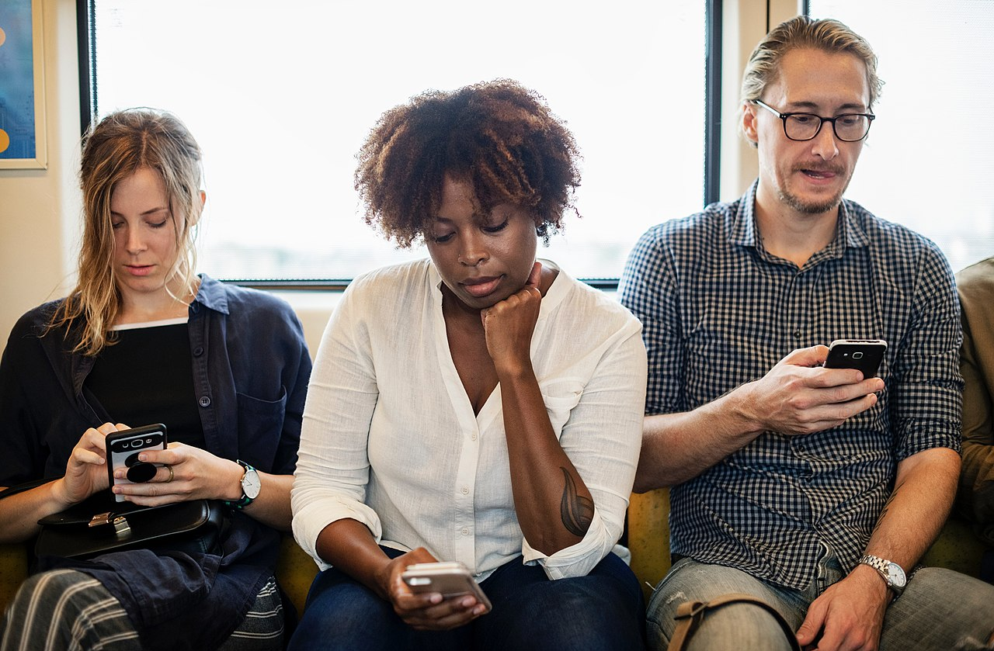
A
B
C
Which of these people is disabled?
Notes:
Question 1: which of these people is disabled?
Is it A, B, C or a combination?
[Alt text: three people sitting on a sofa all using smartphones. The people are marked with the letters A, B and C.].

Slide 33
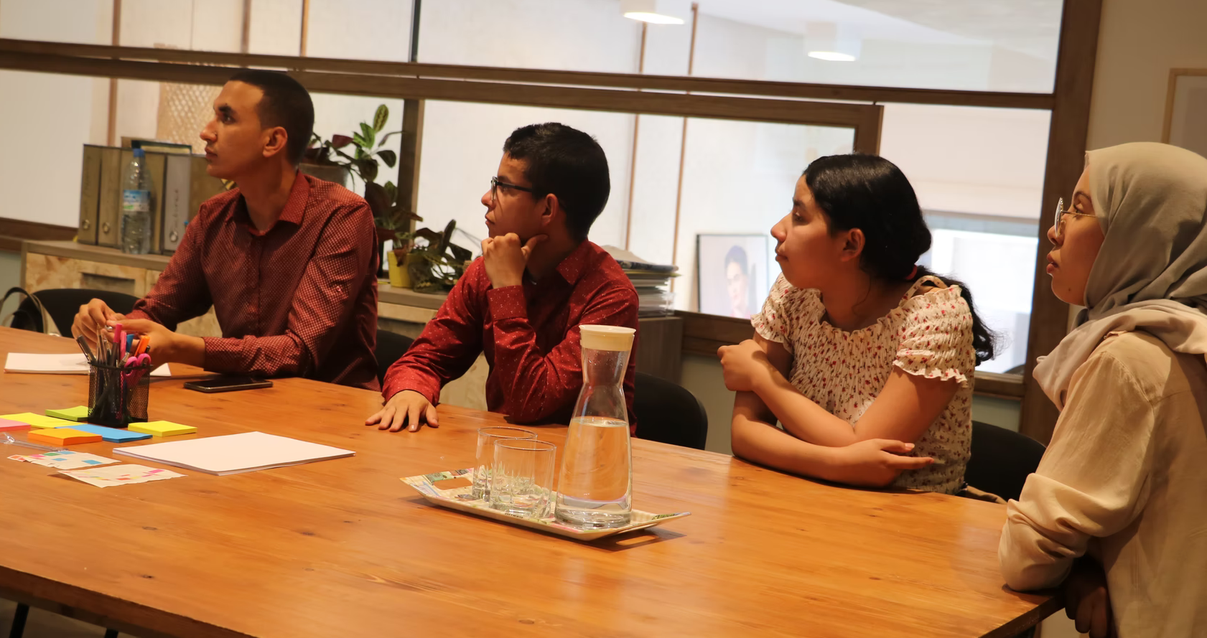
UnSplash
A
B
C
D
Which of these people has dyslexia?
Notes:
Question 1: which of these people has dyslexia?
Is it A, B, C, D or a combination?
[Alt text: four people sitting at an office conference table. The people are marked with the letters A, B, C and D].

Slide 34
14 million disabled people in the UK
how-many.herokuapp.com
Notes:
There are 14 million disabled people in the UK according to the Family Resources Survey 2020.
That’s a lot of us.
Let’s take a look at how that might affect your service.
Can you type into the chat how many people you estimate might use your service?
https://how-many.herokuapp.com/

Slide 35
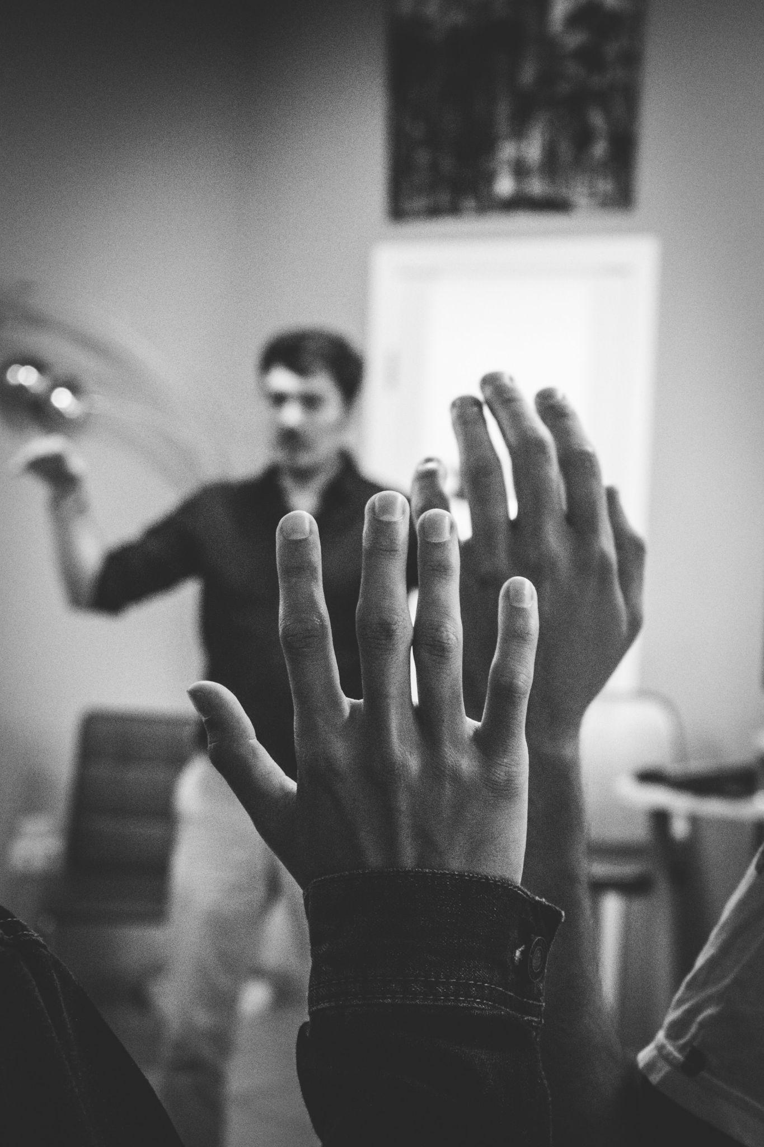
Who do you want to exclude from using your website?
Notes:
So given all of the people who might benefit from accessibility
the question might be
- who do you want to exclude from using your website?
Each barrier that you don’t remove, or add to your service will exclude some people from using your service.
[Image is decorative]

Slide 36
The law
Notes:
We’ve talked about not wanting to exclude people from our service:
Because it’s their right.
Because we want our service to succeed.
Because it’s the right thing to do.
But even if you don’t buy any of that, it’s the law.

Slide 37
Equality Act 2010
Public Sector Regulations
GDS Service Standard
Notes:
The Equality Act came into force 11 years ago. It’s still the overriding legislation for accessibility.
There are the new public sector regulations, which build upon the Equality Act.
And as a government department, the GDS Service Standard may apply to your service. It pre-dates the public sector regulations. It may apply through spend control for some projects.

Slide 38
Accessibility is the law
Equality Act 2010
We have a legal obligation to provide equal access to people with disabilities
Public Sector Equality Duty
We have a duty to be proactive in making things accessible
Notes:
This is true of both public-facing services and non-public facing services
Government is both a service provider and an employer - and the Equality Act covers both service providers and employers
(It’s the Disability Discrimination Act for Northern Ireland)
The Public Sector Equality Duty is part of the Equality Act 2010. We have an obligation to positively promote equality, not merely to avoid discrimination.
Reference: https://www.equalityhumanrights.com/en/advice-and-guidance/public-sector-equality-duty

Slide 39
Public Sector Accessibility
New regulations makes the legal obligation more specific. Public sector websites must:
be accessible to level AA of the Web Content Accessibility Guidelines (WCAG) v2.1
publish an accessibility statement
‘Websites’ includes intranets, extranets, outsourced sites, SaaS, mobile apps and staff-only applications.
Notes:
Regulations came into force in September 2018 - 3 years ago. Websites that existed before the act had until last September to comply. Mobile apps compliant by June 2021.
There’s guidance on GOV.UK: https://www.gov.uk/guidance/accessibility-requirements-for-public-sector-websites-and-apps

Slide 40
WCAG - “wuh-cag”
Notes:
Let’s talk about WCAG.
Most common and internationally accepted standard is the Web Content Accessibility Guidelines - WCAG - I pronounce it “WUH-CAG”.
latest version 2.1 is referenced in the Public Sector Bodies Accessibility Regulations.
It’s a technical standard and can be difficult to understand.
It divides the guidelines into A, AA and AAA. Essentially, these are roughly in order of how great a barrier they present. Single A are usually the priority criteria.
There are 50 success criteria for AA level and that’s what we focus on when we test. We’ll look at some examples later.
Reference https://www.w3.org/TR/WCAG21/
[Alt text: Screenshot of https://www.w3.org/TR/WCAG21/]

Slide 41
Government accessibility requirements

Slide 42
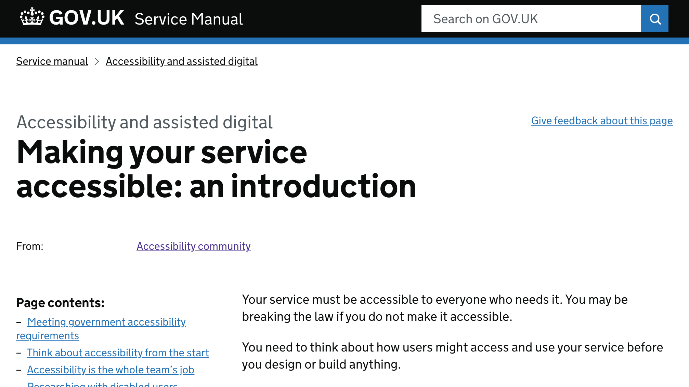
Service manual
Notes:
Point 5 of the service standard “Your service must be accessible to everyone who needs it, including services only used by public servants.”
https://www.gov.uk/service-manual/helping-people-to-use-your-service/making-your-service-accessible-an-introduction
Alt text: screenshot of the above URL - Making your service accessible: an introduction]

Slide 43
Accessibility ≠ assisted digital
Accessibility = having no barriers
Assisted digital = getting support to use a service
Service assessments include both
Notes:
Accessibility means having no barriers
it’s not quite the same as assisted digital
both are requirements for government digital services
The key point is that you can’t make your service not accessible and then provide a call centre number to replace access to your service.
Examples:
“I can use your service with my screen reader” is accessibility.
“I don’t have access needs but I don’t have Internet and I’ve never used a website” is assisted digital.
“I’ve never used the Internet but I’m deaf and I’d prefer to text or email you” is both…

Slide 44
Principles of accessibility

Slide 45
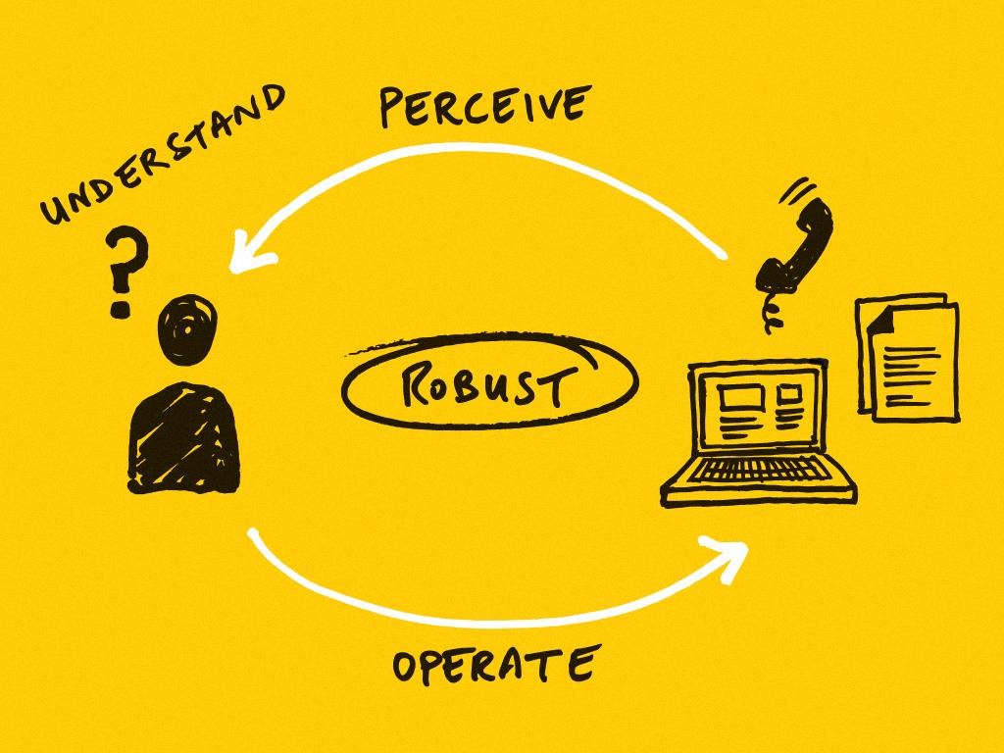
Notes:
On screen we have a small diagram, with a user to the left, who must operate the laptop, phone and documents pictured, to do that, they must perceive this media and understand it in order to operate it. This forms a cycle of perceiving, understanding and operating. At the centre of the loop is the word: “Robust”
To use something, you’ve got to to be able to perceive, understand and operate it. And the thing has to be robust.
We’re using a website in this example, but the principles apply to everything - not just websites.
A user needs to be able to perceive your content - which means your content has to be available to at least one of their senses.
So if a user can’t see something, they can still hear it. Or vice versa.
But it’s not enough just to perceive something, the user has to be able to understand it as well.
I could show you a Polish or Chinese website and you would be able to perceive it, but you might not be able to understand it.
People have different processing ability, for example someone with dyslexia might struggle with long passages of text, so we need to be conscious of this when designing and operating services.
And the user has to be able to operate the thing.
I imagine most people in this room use a mouse or a trackpad when they’re interacting with digital services - but these aren’t the only input devices people use.
Lots of people use a keyboard or speech recognition. Your service needs to work with whatever input device people are using.
And finally the service needs to be robust. That means it been implemented in such a way that it works with the technologies that people use - such as a screen reader.
These are the 4 key elements - if just one of these breaks down then the user won’t be able to do what they need to do.
We’re going to go through this in a bit more detail one-by-one.

Slide 46
Perceivable
Make content and controls perceivable by all users

Slide 47
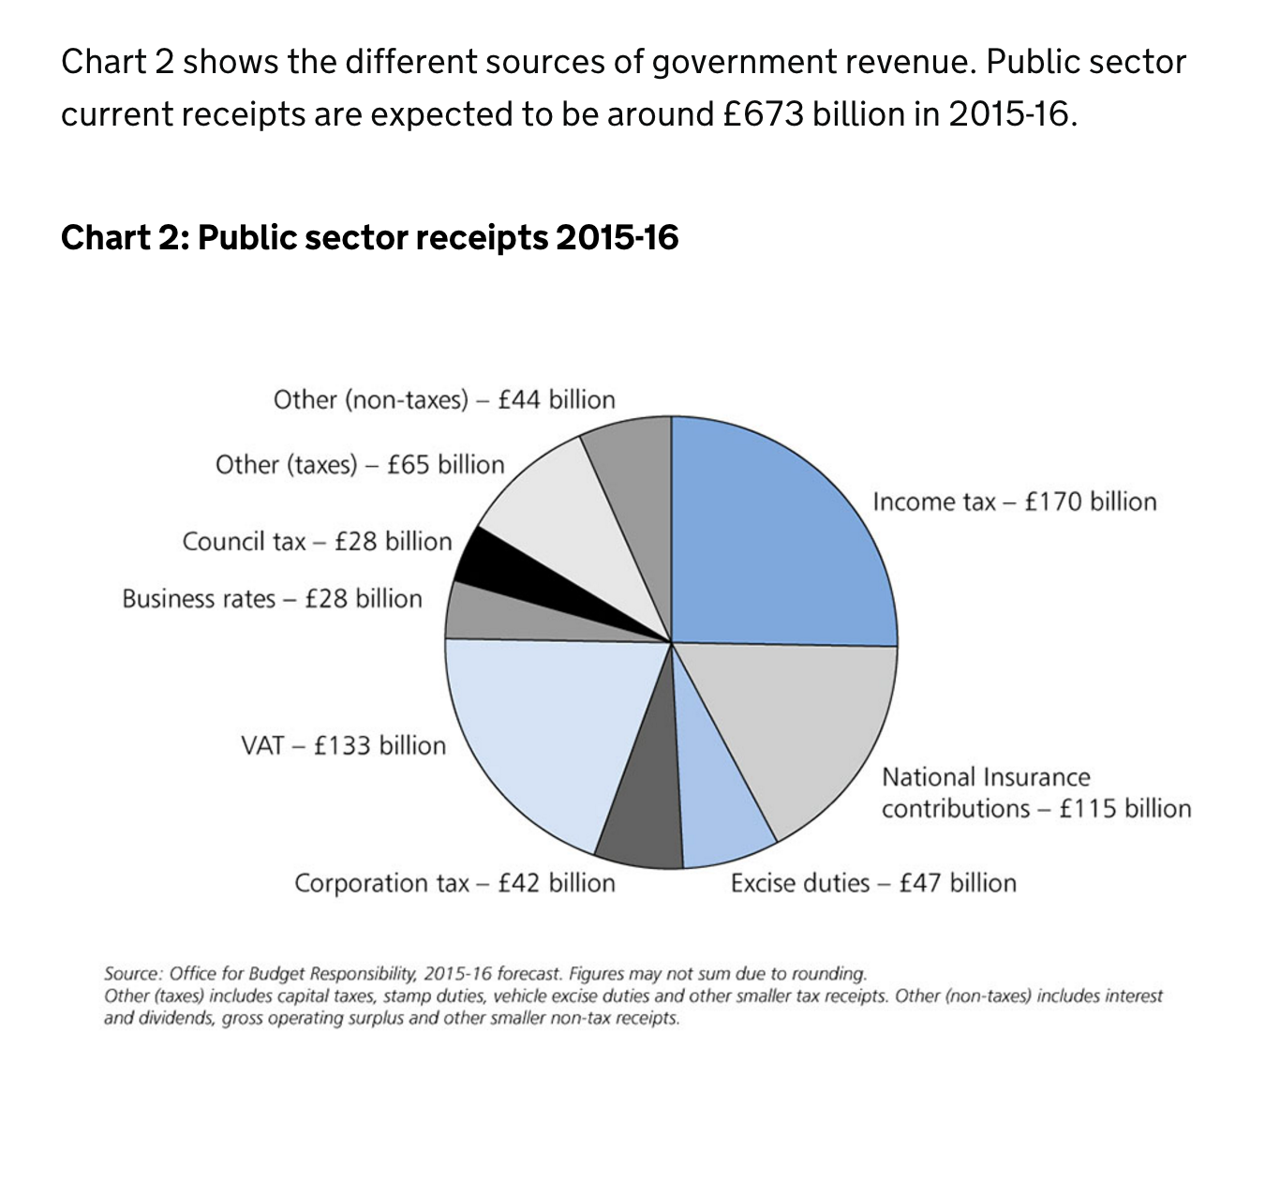
Provide appropriate text alternative for images
1.1.1 Non-text content (A)
Alt: “Public sector receipts 2015-16”
Notes:
Screen readers cannot read text in images.
Sighted user will get a lot of information from the visual.
A screen reader user will only get this information if it is also provided as text.
Example of a pie chart.
Alt text was simply the title (“Public sector receipts 2015-16”)
A screen reader user would miss all the information communicated by the image.
Notice the reference “1.1.1 Non-text content (A)”. This is a short reference to a WCAG success criterion. You don’t have to remember this, but if you see audit results or accessibility statements, you’ll see this a lot so it’s worth starting to get used to it.
The first part of the number tells us which section of WCAG it’s in - in this case 1 “Perceivable”.
The last bit is the level - single A are considered more of a barrier than AA.

Slide 48
Removed because presentation was slightly too long
Don’t communicate solely with colour.
It’s difficult for people with colour deficiency (and also if printed in greyscale!)
To fix, use another method as well.
1.4.1 Use of Colour (A)
Notes:
If you communicate something using colour alone, then someone with colour-blindness might not be able to perceive it and might be excluded from your content
To a user with red-green colour-blindness it’s very difficult to differentiate between a win and a loss
You can still use colour to indicate things, but not on its own.

Slide 49
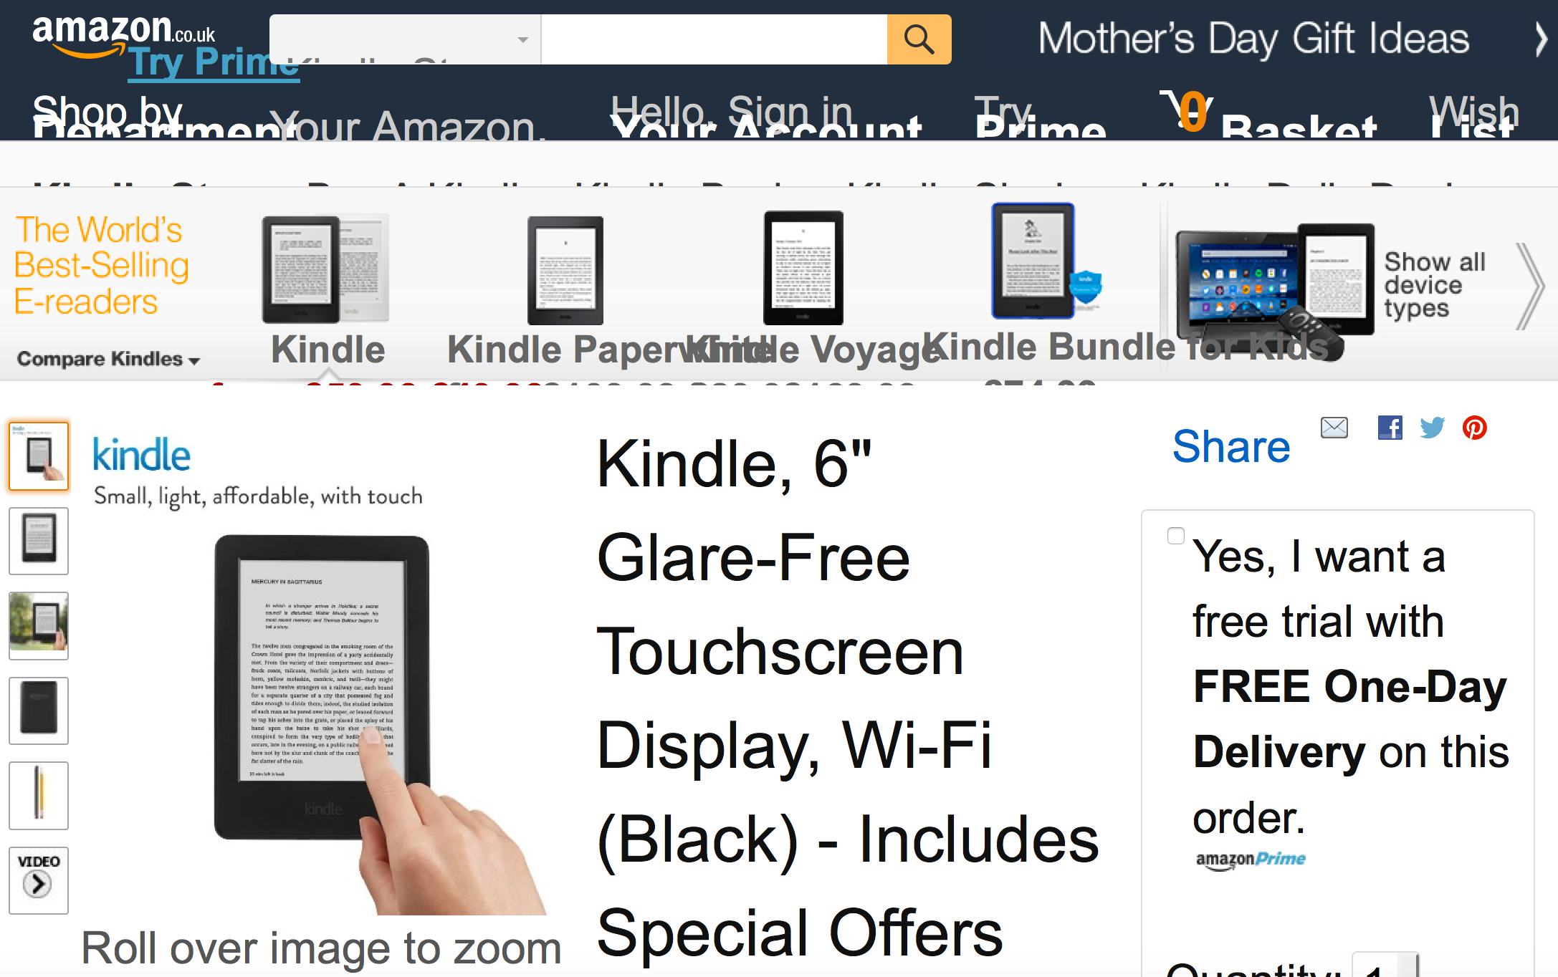
Removed because presentation was slightly too long
Allow users to change text size (and not just through browser zoom).
1.4.4 Resize text (AA) and 1.4.10 Reflow (AA)
Notes:
If you enlarge the text on Amazon’s website the navigation becomes unreadable.
In the private sector it may be bad business
In the public sector we are excluding people

Slide 50
Users need to be made aware of new content.
Mainly 3.2.2 On Input (A) but generally “...user interface … must be present[ed] to users in ways they can perceive”
“uni … 4 results are available”
Notes:
Dynamic content example: autocomplete.
Sighted user can see four suggestions.
The same information needs to be made available to a screen reader user.

Slide 51
Removed because presentation was slightly too long
Videos need captions and transcripts.
1.2.2 Captions (prerecorded) (A)
Notes:
Videos without captions and/or transcripts exclude people with hearing impairments
by making something accessible, you’re improving the experience for everyone:
if the video fails to load, the user would still be able to get the content, through the text description
and search engines will be able to index it as well
https://www.gov.uk/government/case-studies/on-the-frontline-of-ebola
TODO: look for a different example as this video has captions now

Slide 52
Operable
Make content and controls operable by all users

Slide 53
Make all functionality available from a keyboard.
2.1.1 Keyboard (A)
Where to find this
Notes:
In this example, the help image is only available if you point (hover) over the link.
That means it is not available to people who use a trackpad or don’t use a mouse.
In general, testing with keyboard only also uncovers a lot of issues for screen reader and voice control users

Slide 54
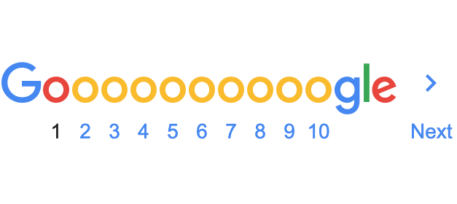
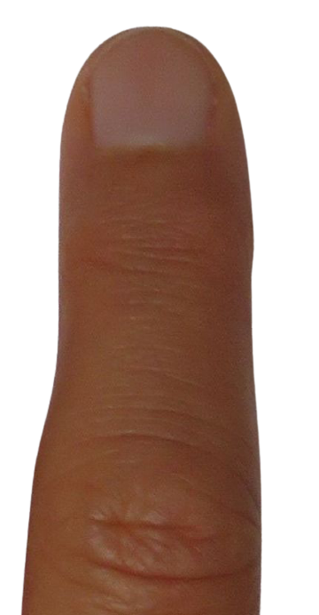
‘Target’ sizes - where you touch or click - should be large enough for users to easily activate them, even if the user is accessing content on a small touch screen device, or has limited dexterity.
2.5.5: Target Size (AAA)
Notes:
large hit areas for links, buttons and controls important for users with motor impairments, using a touch interface or have difficulty controlling a mouse
pagination links very close together might make it hard to select the correct link
This is a triple A but it is important.

Slide 55
Understandable
Make content and user interfaces understandable to all users

Slide 56
Removed because presentation was slightly too long
If there are any points on which you require explanation or further particulars we shall be glad to furnish such additional details as may be required by telephone.
Write in clear language (Plain English).
Organise information into manageable chunks - using headings and bullet points.
Only include content that meets a user need.
If you have any questions, please phone.
Notes:
lots of people can struggle to understand complex language

Slide 57
When data must be entered in a specific format or in a particular way, clear instructions must be associated with the form field.
3.3.2 Labels or instructions (A)
When an error occurs, the user is informed what caused the error, and the error is described in text.
3.3.1 Error identification (A)
Your reference number
Your reference number For example, AB123
45678
Your reference number For example, AB123
45678
!
Your reference number For example, AB123
Enter a reference number in the correct format
45678

Slide 58
Robust
‘Robust’ means the digital service must work reliably with all supported browsers and assistive technologies. Think robust = “must not break stuff”.

Slide 59
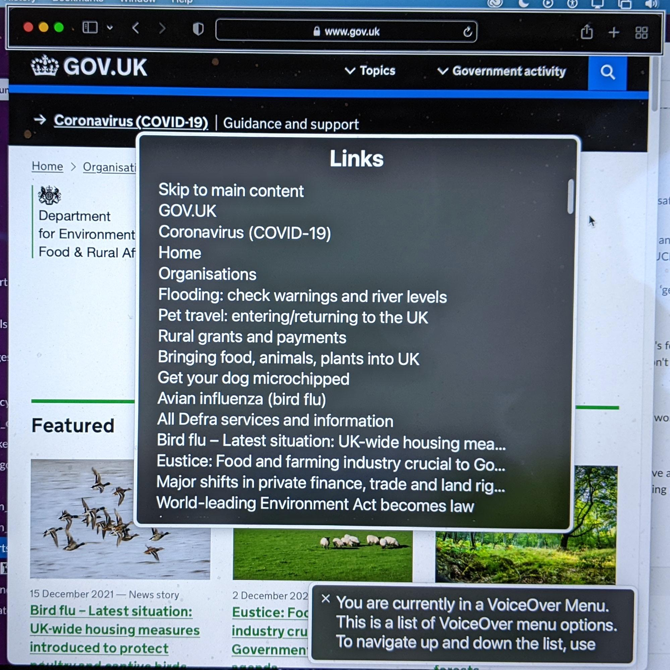
Your service needs to work with the technology that people use.
Test your service with a range of assistive technologies.
4.1.2 Name, role, value (A)
Notes:
…like screen readers, screen magnifiers and dictation software
The screenshot shows a feature of most screen readers - you can choose to display a list of links - or in fact headings and other parts of the page.
This is why choosing good link text and hedding is so important - screen reader users will use them as additional navigation for the page.

Slide 60
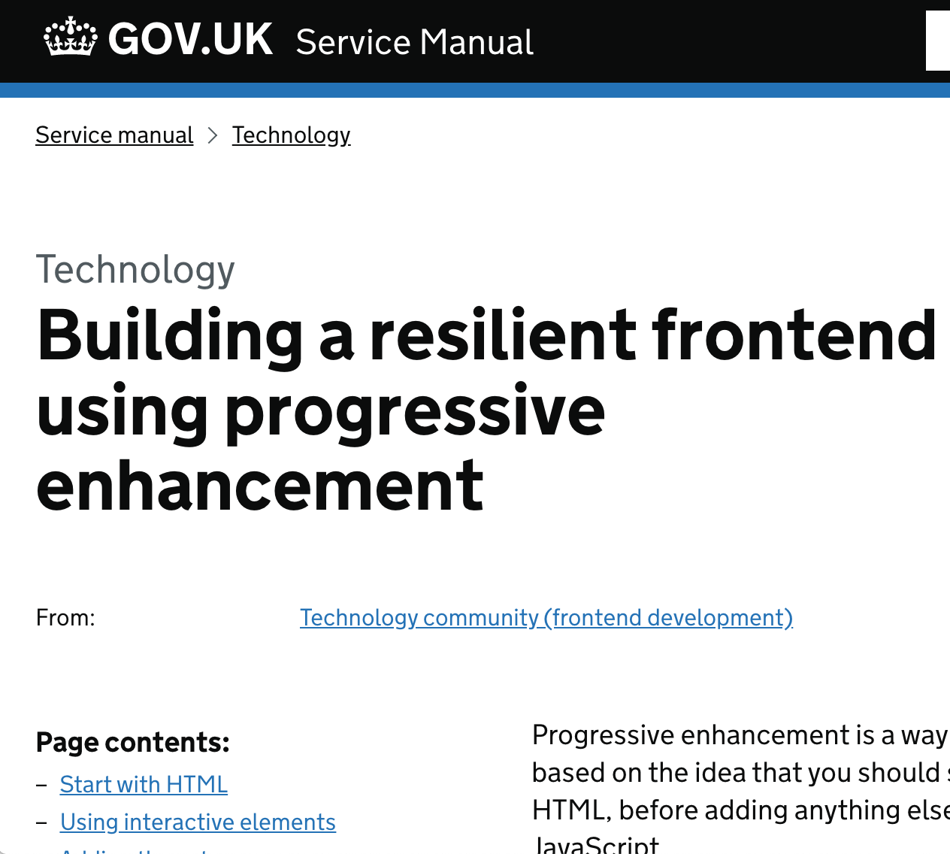
Removed because presentation was slightly too long
Frontend developers need to write HTML, CSS and Javascript based on standards for these technologies to work.
4.1.1 Parsing (A)
Notes:
your website needs to work with HTML alone,
presentation layer and enhanced interactions should be optional
so that if the CSS and the Javascript fail to load, the website will still work
Assistive technology CAN handle JavaScript (now)
HTML, CSS, JS all need to be valid to pass 4.1.1 parsing
https://www.gov.uk/service-manual/technology/using-progressive-enhancement

Slide 61
Assistive technology
Notes:
Assistive technology is any object or system that increases or maintains the capabilities of people with disabilities.

Slide 62
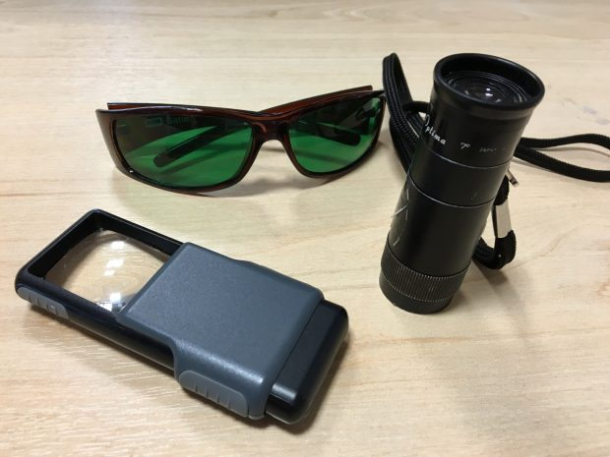
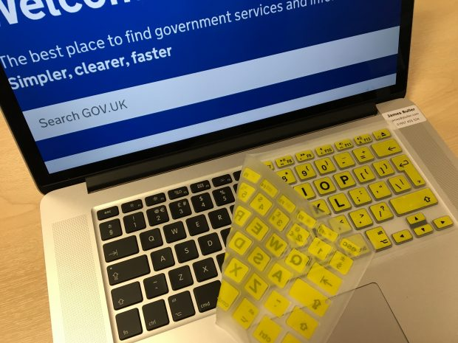
It’s not just screen readers!
Notes:
Tinted glasses
Magnifier
Monocular (mini telescope)
High contrast keyboard overlay
source: https://accessibility.blog.gov.uk/2016/08/22/accessibility-and-me-james-buller/

Slide 63
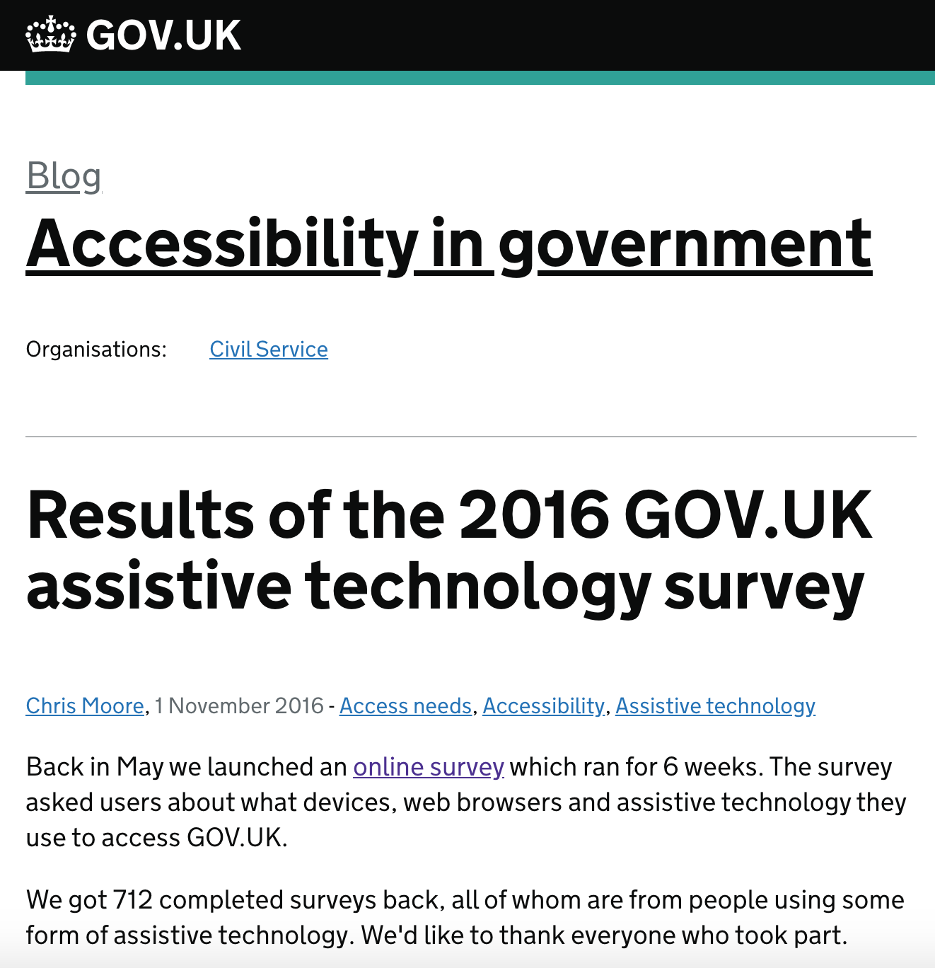
Most used assistive software
30% screen magnifier
29% screen reader
18% voice control
15% readability
People also adjust their browser settings - text size, colour - or use different input devices.
Notes:
Screen magnifier - eg ZoomText.
Screen reader - mainly JAWS and VoiceOver.
Voice control - almost exclusively Dragon Naturallyspeaking for Windows.
Readability - assistance for people with dyslexia - main Read and Write. Read and Write users often have had Dragon Naturallyspeaking running in parallel.
Source: https://accessibility.blog.gov.uk/2016/11/01/results-of-the-2016-gov-uk-assistive-technology-survey/

Slide 64
A process for making things
accessible

Slide 65
Making services accessible is not hard
Notes:
But you can make it harder for yourselves. Here are a few recommendations to make it as painless as possible.

Slide 66
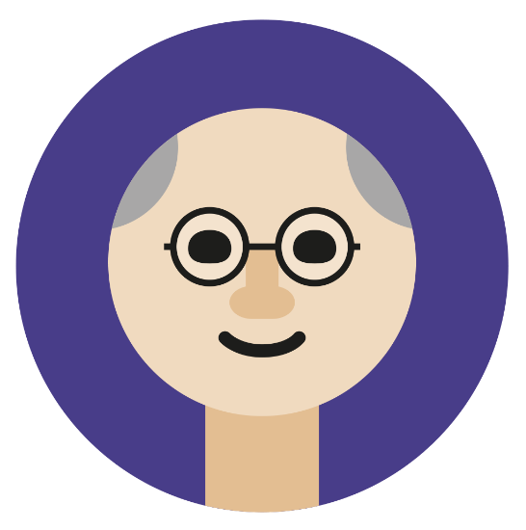
1. Research access needs and think about accessibility from the start.
Notes:
Don’t wait until just before you go live to start thinking about accessibility
Consider accessibility throughout

Slide 67
Research access needs: who to include when
Notes:
https://github.com/UKHomeOffice/posters/blob/master/accessibility/researching-access-needs/Research-who_to_include_when%3F.pdf

Slide 68
2. Consider end-to-end as well as digital
Find out what you have to do
Check the guidance
Register online
Print paper certificate
Scan with mobile
Not just this bit
Notes:
In any service there are many touch points where users may experience barriers to using the service.
A printed document may be hard to read, or be hard to understand. People with low vision may not be able to read it.
You may make assumptions about how technology works for the user that are not correct for certain access needs.

Slide 69
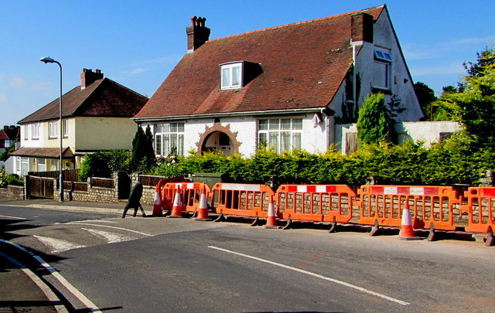
Removed because presentation was slightly too long
Barriers and speed bumps
Notes:
We sometimes describe problems we find with websites as ‘barriers to accessibility’.
I want to talk also about ‘speed bumps’ and make the case that you should consider these too when you design your service.
[Alt: Road with a sleeping police officer hump and a set of roadwork barriers preventing use of the pavement]

Slide 70
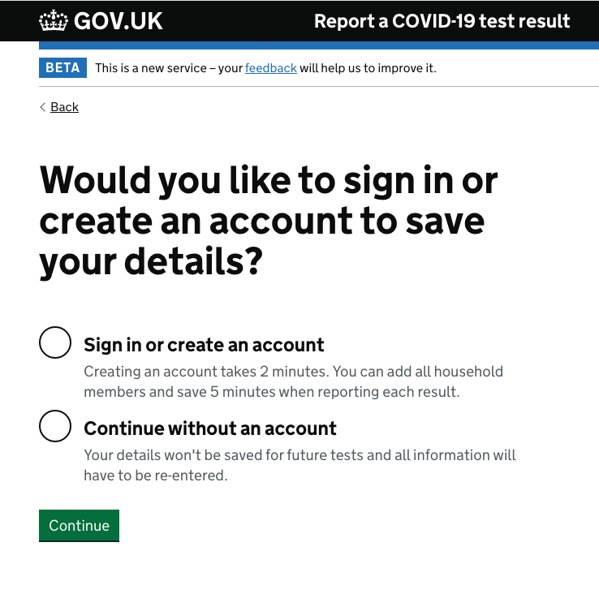
Removed because presentation was slightly too long
Barrier
Notes:
Here’s the login screen for the report a covid test site.
A person using dictation software - for example Dragon - or a screen reader like JAWS will need to be able to link the words in the radio button label to the correct control. The screenshot on the right shows what ‘accessible names’ as we call them are available. A fairly common error we see is where this link is broken - either a small copy-paste error or it’s missed in development or QA. When that happens, it can be impossible for these people to use the form. It’s a barrier - one we can remove but still a barrier until it’s fixed.

Slide 71
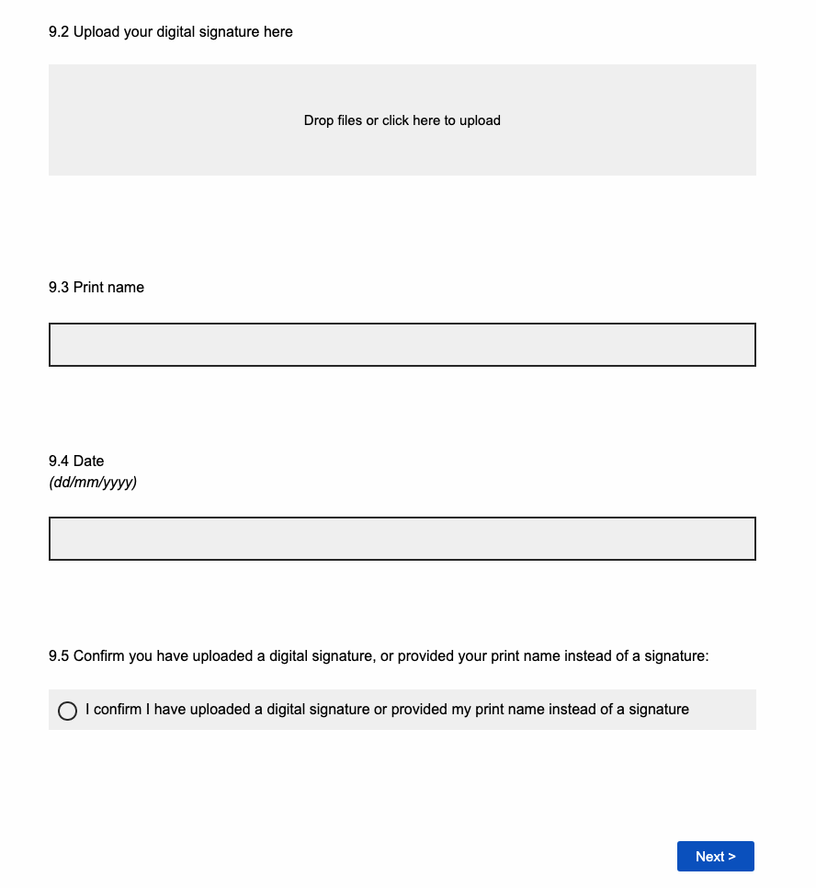
Removed because presentation was slightly too long
Speed bump
Notes:
Here’s another service. They have decided that their online form should work like a paper form and have a signature. In fact it’s not quite like that because they also allow a print name.
Note that a person using high magnification or a screen reader might miss that option and assume that they have to upload the signature.
Anyhow, let’s look at the steps involved in completing this task.

Slide 72
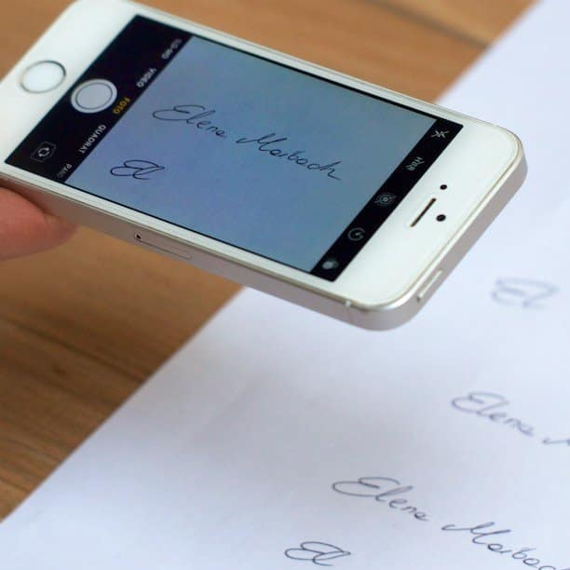
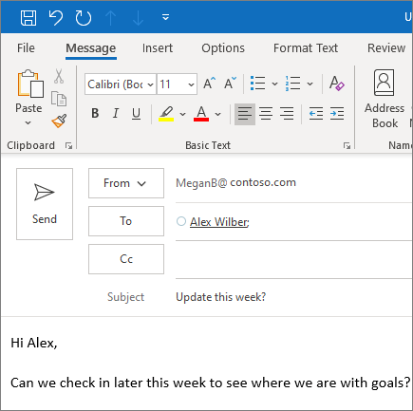
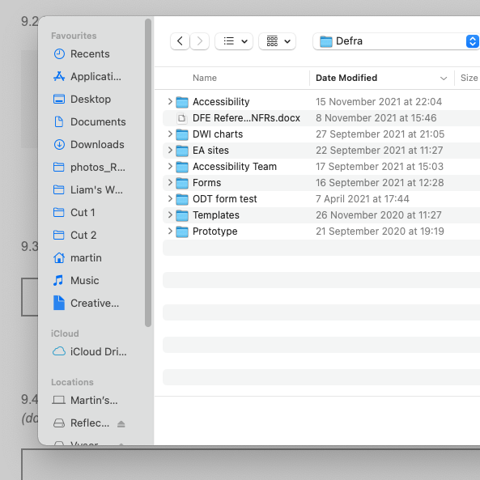
Removed because presentation was slightly too long
1
2
3
4
5
6
Notes:
1. Read and understand the question.
2. Find pen and paper and physically sign (even if you are blind or have reduced mobility)
3. Scan or photograph the signature (you might already have this file)
4. Possibly, email it from your phone to the computer you are using
5. Find the file in your folder structure - is it in downloads, desktop, your last folder or somewhere more tidy?
6. Finally, upload it to the form - or at least you hope it’s finally - what if the file size is too big, or in the wrong format, or you’re on a slow connection?
All of this could be made “accessible” but if we could remove the need for this - could we make it more truly accessible?
So look out for speed bumps in your service

Slide 73
3. Design an accessible service
User capabilities
Tasks and journey
Content
Patterns
Components
Code
Tech stack
Notes:
You need to consider everything that affects accessibility and design to remove barriers for people.
You can’t design user capabilities, but you can design for them, their hardware and their software.
Legislation and policy might constrain the tasks and journey that you design, but whilst we often think about lower level things like links and forms, it is often the whole service that poses the barriers.
Content is key. If I can’t understand at first reading what you are trying to communicate, I can’t use your service. But there are also specific content issues such as headings and link text that needs work.
Selecting and designing the overall pattern for an interaction will help make it easy for people to complete an individual task.
Use the GDS Design System components well and correctly.
Quite a few of the issues we see are where code does not parse or has duplicate IDs, or incorrect (or too many) ARIA attributes. Care and testing helps here.
Even though the user doesn’t seem to interact directly with the tech stack, it often has a big impact. Think about authentication loops, password requirements, data definitions, time outs, search capability and all the pages you hope people do not see - 404 page not found, site under maintenance.

Slide 74
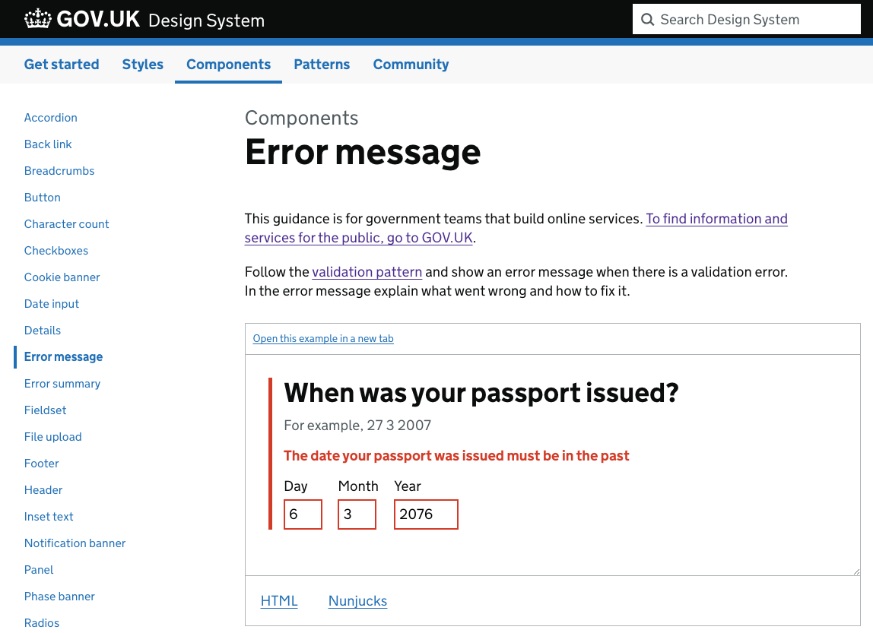
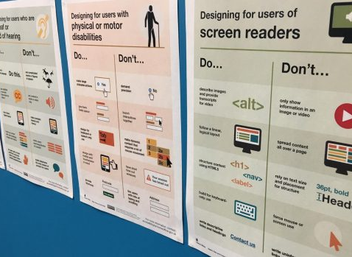
4. Build accessibly
If you use the design system, use it correctly
Use accessibility acceptance criteria or definition of done
Notes:
The GDS design system is a fantastic resource. Use it if you can as it’s mostly accessible. But it’s possible to use it to make in accessible services.
Common errors are:
Misusing components and patterns.
Code mistakes.
Poor content.
Not allowing enough time to build new components.
For more on acceptance criteria se https://insidegovuk.blog.gov.uk/2018/01/24/improving-accessibility-with-accessibility-acceptance-criteria/

Slide 75
5. Test as you go along
Final audit
S1
S2
S3
S4
S5
Broken release
Panic fixes
Debt and test cramming
Design + test
Design + test
Design + test
Design + test
Assure
S1
S2
S3
S4
S5
Bug free release
Accessible development
Notes:
You really don’t want to be in your beta assessment, or in the go live preparation meeting only to discover that you have a load of accessibility issues to fix.
Or that you don’t even know if you have issues.
Use acceptance criteria and continuous testing to check as you go along.
You can build some automated checking into your build pipeline - but don’t rely on it.
You will still need some kind of audit or assurance process so you have evidence to write your accessibility statement. But that will be easier if you’ve been testing as you go along.

Slide 76
Tips for testing
Testing is a team sport - everyone can help.
Automated testing is not enough (13%-40% of issues).
But do use an automated accessibility testing tool first.
Perform manual checks using a checklist.
Test with assistive technologies - there’s a list on GOV.
Start by being pragmatic: a desktop screen reader; voice recognition; screen magnification.
Include users with access needs in your user research.
Get an expert to audit the accessibility of your service.
Notes:
Tools examples:
Tenon
Axe
WAVE
Siteimprove
Checklist - best create your own checklist but here is a ready-made one:
https://accessibility.18f.gov/checklist/
Assistive technology: https://www.gov.uk/service-manual/technology/testing-with-assistive-technologies

Slide 77
Learn how to do basic checks
Operate with keyboard only
Zooming the text
Correct use of links and headings
Checking for basic plain English
“Eat your own dog food” - try a typical user journey, including triggering errors
Try it on different screens, tablets and mobiles
Check for timeouts or popups that can’t easily be disabled

Slide 78
Ask the ‘A’ question
Is this accessible??
Notes:
If other people are working with you:
Defining requirements
Supplying content
Creating text or documents
Ask the ‘A’ question - is this accessible? Has it been checked?

Slide 79
Whose job is it?
Notes:
The DWP accessibility manual is a good reference to read about how each role in a team can contribute to good accessibility.
https://accessibility-manual.dwp.gov.uk/guidance-for-your-job-role

Slide 80
To sum up

Slide 81
Summary
Good accessibility helps everyone but it’s essential for disabled people.
Discuss in your team how to plan in accessibility from the start.
As individuals, learn a bit more about accessibility.
Build a process for accessibility into your existing ways of working.
Notes:
These are the things you need to do.

Slide 82
Get advice
There’s excellent guidance on GOV.UK.
If you need help or advice contact us accessibility@defra.gov.uk
Any questions?

Slide 83
Give feedback
Give your feedback on the Defra accessibility introduction session

